Slide 1

ML-Based Loan Approval Prediction System
A machine learning framework that analyzes applicant financial and personal data to deliver fast, consistent, and data-driven lending decisions.
ACADEMIC PROJECT
MACHINE LEARNING
FINANCIAL TECHNOLOGY
A.Uma
323129510002

Slide 2

The Challenge: Manual Loan Processing
⏱ Delays
Manual reviews take days or weeks, frustrating applicants and slowing portfolio growth.
⚠️ Inconsistency
Human judgment varies by officer, branch, and time — producing unequal outcomes.
❌ Errors
Data-entry mistakes and overlooked signals increase default risk and compliance exposure.
📊 Poor Scalability
Traditional methods cannot handle high-volume application surges without major staffing costs.

Slide 3
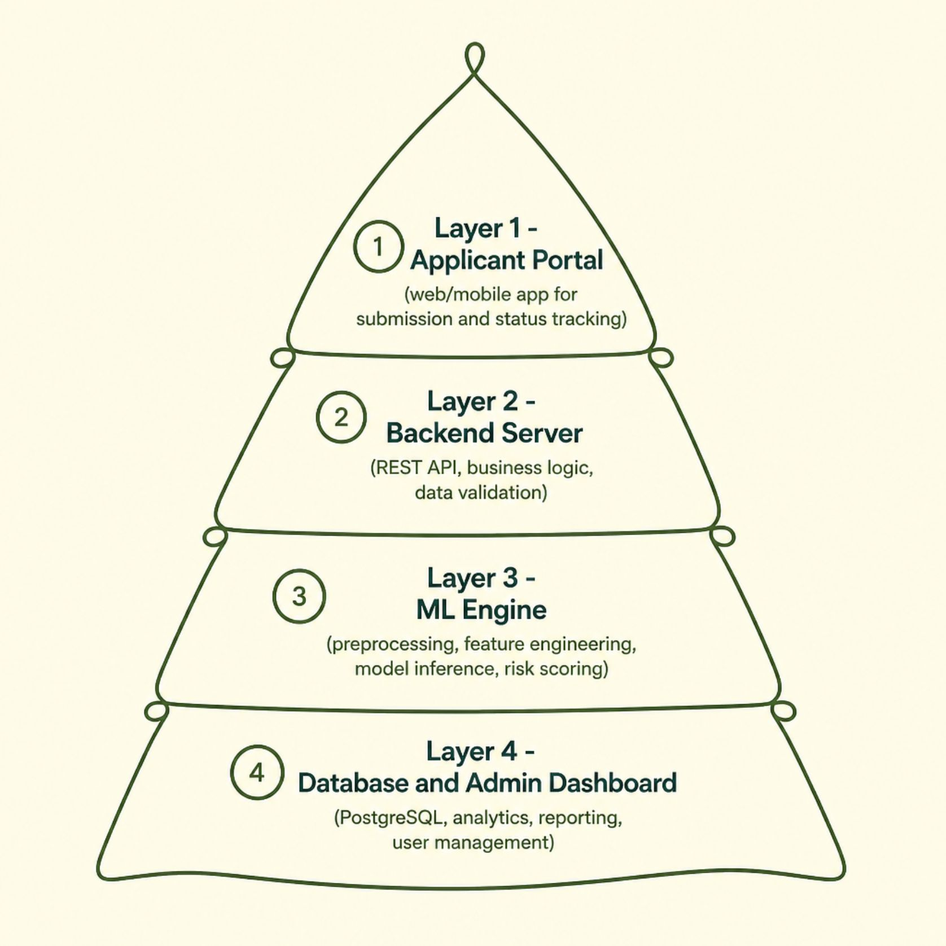
System Architecture & Workflow
End-to-End Data Flow
The system operates as a closed-loop pipeline from submission to decision:
Applicant submits data via secure portal
Backend validates and preprocesses input
ML engine generates approval probability
Officer reviews recommendation and decides
Decision stored; applicant notified instantly

Slide 4
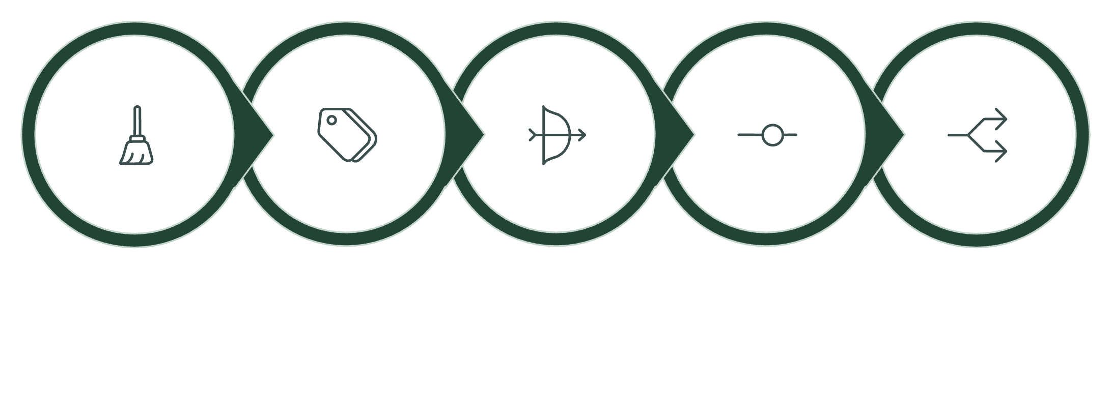
Dataset & Feature Engineering
Preprocessing Pipeline
Core Input Features
The model uses structured applicant data drawn from credit bureaus, application forms, and institutional records.
Data Cleaning
Encoding
Scaling
Feature Selection
Train-Test Split
Stratified splitting preserves class balance; correlation matrices and VIF scores eliminate multicollinearity before training.
Financial: Applicant income, co-applicant income, loan amount, loan term
Credit: Credit history (0/1), existing liabilities, repayment capacity
Personal: Education, employment status, marital status, dependents, property area

Slide 5
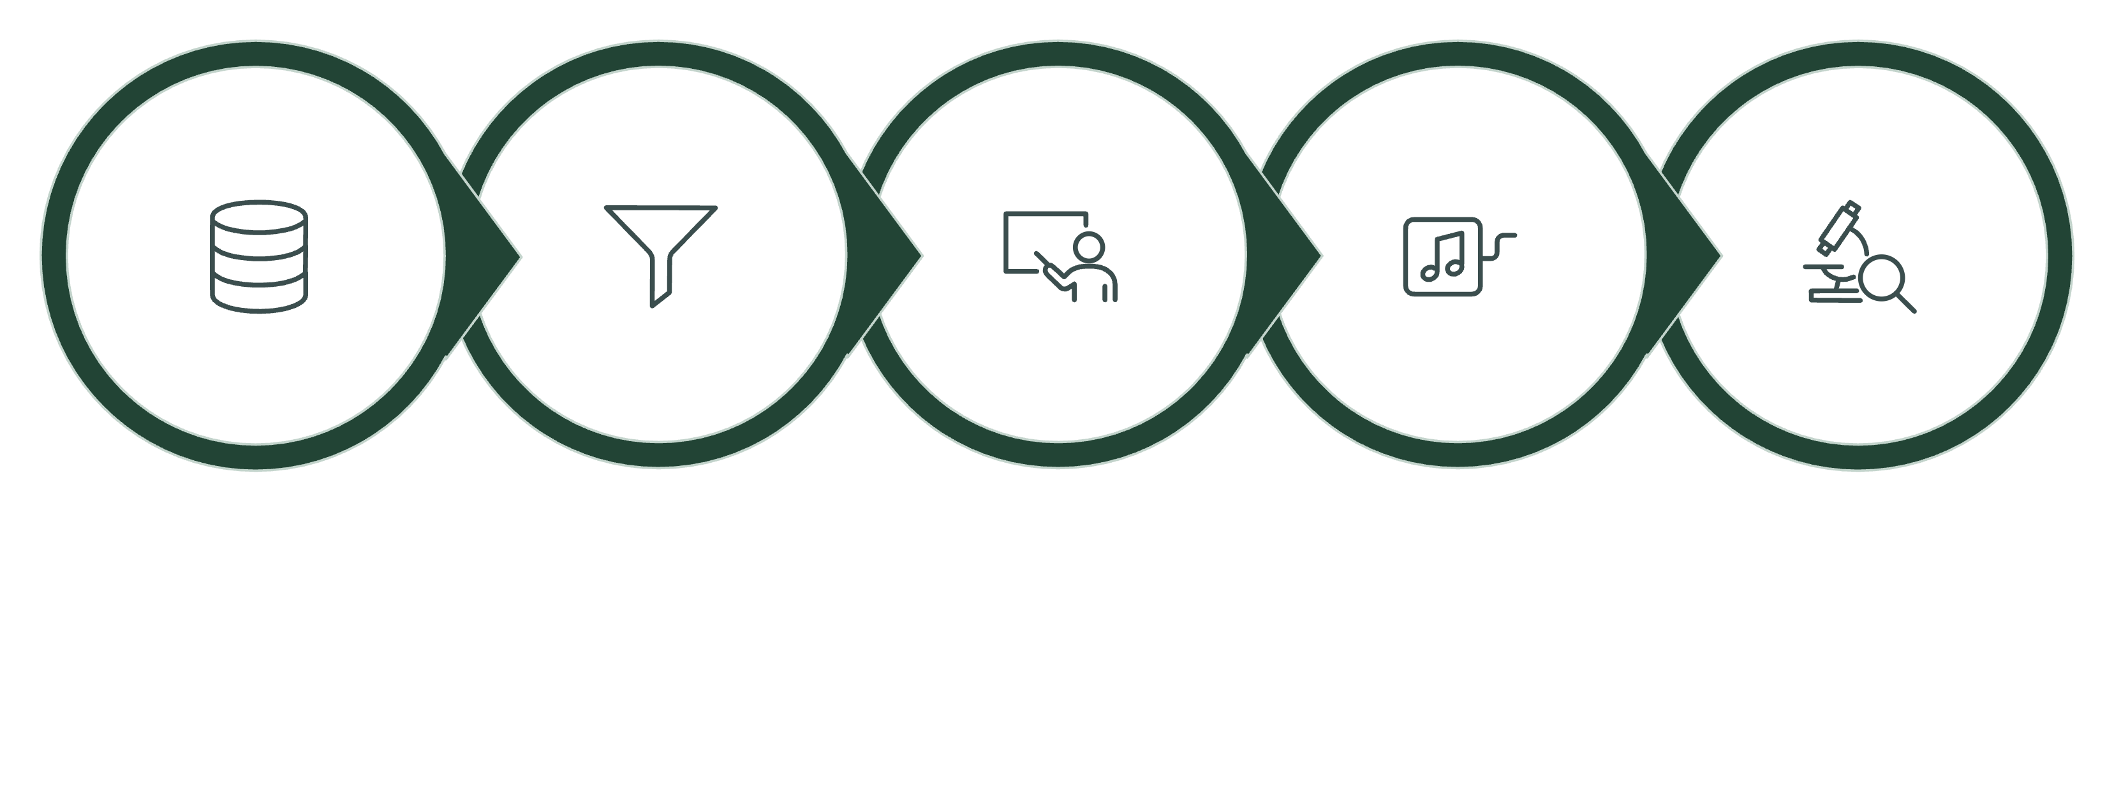
Machine Learning Pipeline
Hyperparameter Tuning
Preprocessing
Model Training
Raw Data
Evaluation
Five classifiers are trained and compared. Random Forest and XGBoost consistently outperform linear models on imbalanced lending data, with ensemble methods reducing variance and capturing non-linear feature interactions.

Slide 6
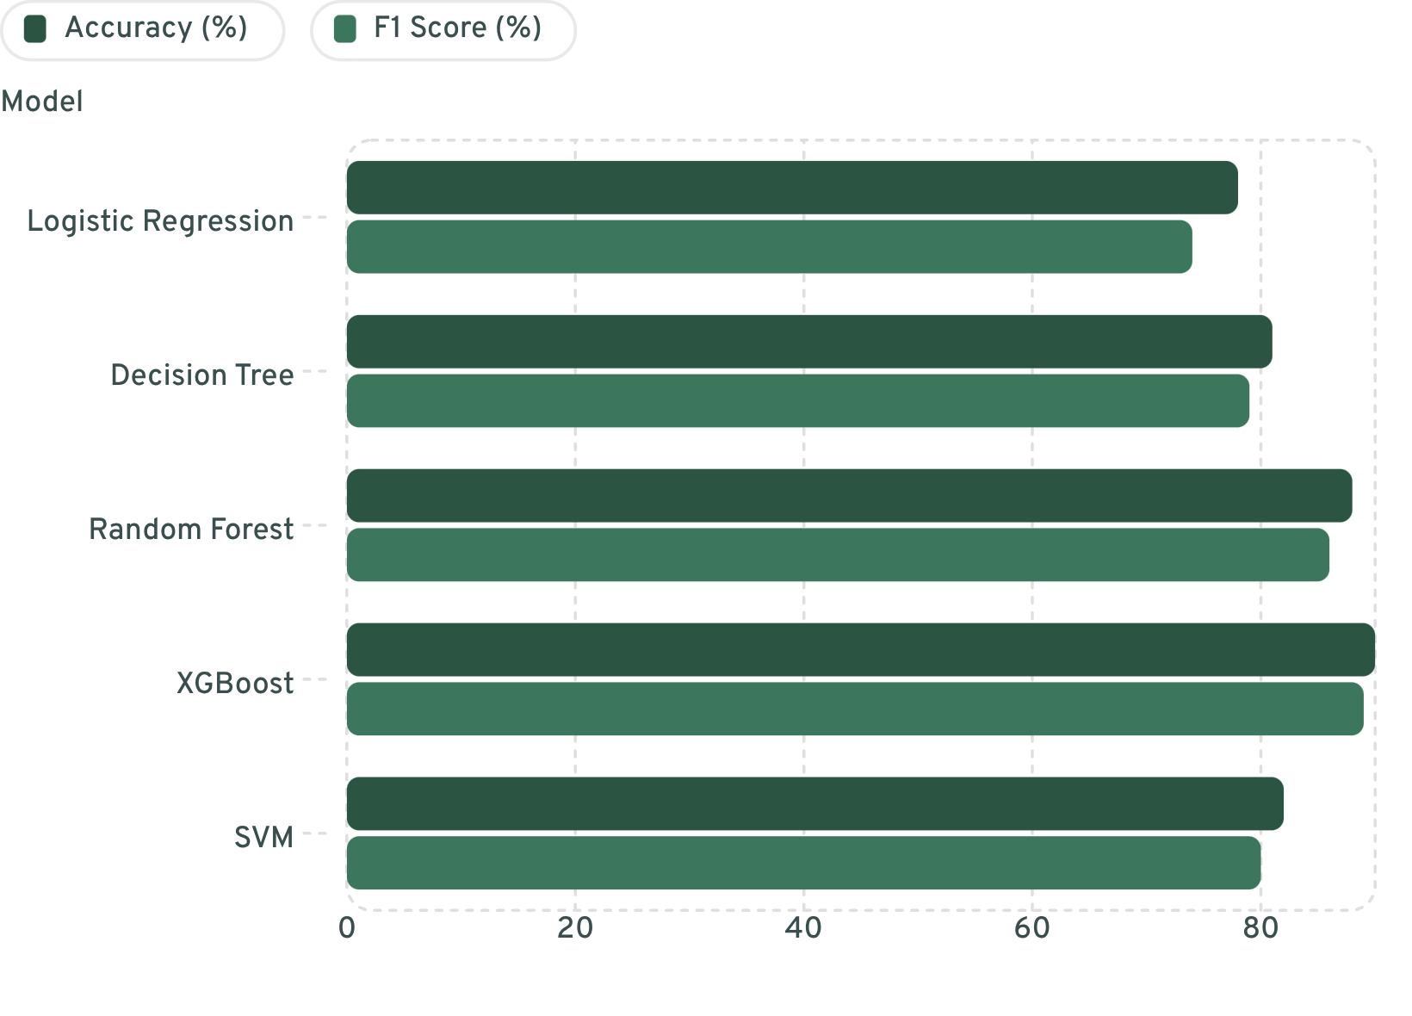

Model Evaluation & Comparison
Performance Highlights
XGBoost achieves the highest accuracy (90%) and F1 score (89%), making it the recommended production model. Random Forest is a strong alternative with better interpretability.
Confusion Matrix (XGBoost): TP=142, TN=98, FP=12, FN=8 — indicating low false-negative rate, critical for minimizing credit risk.

Slide 7
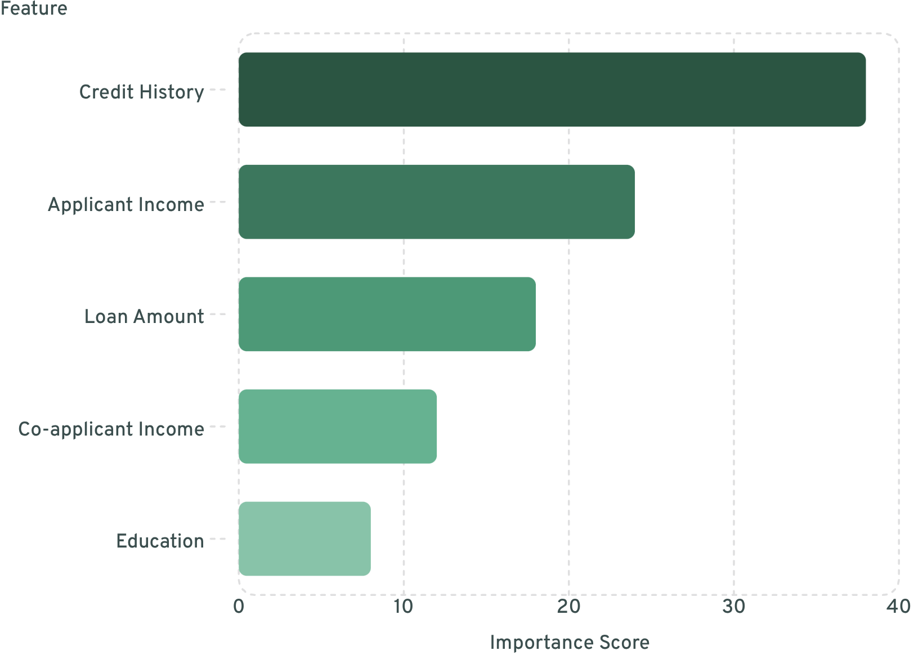
Feature Importance Analysis
What Drives the Decision?
Credit history dominates at 38% — a strong binary signal of past repayment behavior. Applicant income and loan amount jointly determine debt-to-income ratio, the second most critical risk factor.
Lower-ranked features (education, marital status, dependents) provide contextual nuance but rarely override credit and income signals in the final prediction.

Slide 8



User Roles & System Modules
Applicant
Bank Officer
Administrator
Submits applications, uploads documents, tracks real-time status, and receives automated approval or rejection notifications.
Validates submissions, reviews ML risk scores, overrides decisions when needed, and manages the approval queue.
Manages users and permissions, monitors system health, generates compliance reports, and retrains models with new data.

Slide 9

Security, Database & Technology Stack
Authentication
JWT-based sessions with role-based access control (RBAC); bcrypt password hashing; optional 2FA for officers.
Database Design
PostgreSQL with normalized schema: users, applications, predictions, documents, audit_logs. Encrypted at rest via AES-256.
Tech Stack
Python (scikit-learn, XGBoost, pandas), Flask/FastAPI backend, React frontend, PostgreSQL, Docker for deployment.
Analytics Dashboard
Real-time approval rates, default risk trends, feature drift monitoring, and exportable PDF compliance reports.

Slide 10
Outcomes, Limitations & Future Directions
✅ Expected Advantages
⚠️ Limitations & Roadmap
Speed: Decisions in seconds vs. days
Current Limits: Model bias risk, cold-start for new applicant profiles, dependency on data quality
Consistency: Uniform criteria across all applications
Future Enhancements: Deep learning (LSTM for time-series credit behavior), explainable AI (SHAP/LIME), real-time credit bureau API integration, mobile-first UX
Scalability: Handles thousands of applications without added staff
Risk Reduction: Lower default rates through data-driven scoring
Real-World Fit: Deployable in commercial banks, credit unions, fintech lenders, and microfinance institutions

